Slide 1
KALAIMATHI S.
821721104024
BE COMPUTER SCIENCE AND ENGINEERING
SIR ISSAC NEWTON COLLEGE OF ENGINEERING
AND TECHNOLOGY

Slide 2
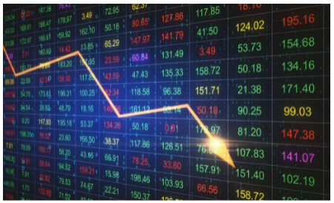
STOCK MARKET PREDICTION(RNN)

Slide 3


AGENDA
Certainly, here's a streamlined agenda for a stock market
prediction presentation:
1. Introduction : Overview of stock market prediction.
2. Data Collection and Preparation : Sources of data, Preprocessing steps.
3. Feature Engineering : Selection of relevant features.
4. Model Selection : Overview of different prediction model.
5. Model Training and Evaluation : Training models, Evaluation metrics.
6. Market Sentiment Analysis : Impact of sentiment on market.
7. Risk Management Strategies : Importance of risk in trading.
8. Case Studies and Examples : Showcase successful prediction model.
9. Challenges and Limitations : Limitation of prediction model.
10. Future Directions : Emerging technology and their impact.
3/21/2024 Annual Review

Slide 4

PROBLEM STATEMENT
The problem statement of stock market prediction using Recurrent Neural Networks (RNNs) involves developing a model that can accurately forecast future stock prices based on historical data. This typically includes features such as past stock prices, trading volumes, and possibly other relevant indicators. The goal is to leverage the sequential nature of stock market data and the memory capabilities of RNNs to capture temporal dependencies and make predictions with reasonable accuracy.
The problem statement of stock market prediction involves using historical stock market data to forecast future stock prices accurately. This typically includes factors like past stock prices, trading volumes, and other relevant indicators. The goal is to develop predictive models that can leverage patterns and trends in the data to make informed predictions about future market movements, aiding investors and traders in making informed decisions.

Slide 5

PROJECT OVERVIEW
Title: Stock market prediction
Objective: The objective of stock market prediction is to forecast future movements in stock prices or market indices accurately. This is done by analyzing historical data and identifying patterns or trends that can be used to make informed predictions about future price movements. The primary goal is to provide investors and traders with valuable insights that can help them make better decisions, such as buying or selling stocks at the right time or adjusting their investment strategies based on anticipated market movements.
Ultimately, the objective is to improve investment returns and minimize risks in the stock market. Stock market prediction is the process of forecasting future movements in stock prices and market trends based on various factors such as historical data, technical analysis, fundamental analysis, and market sentiment. It involves using mathematical models, statistical techniques, and machine learning algorithms to analyze past market data and make predictions about future price movements.

Slide 6
WHO ARE THE END USERS?
The end users of stock market prediction using Recurrent Neural Networks (RNNs) can vary widely and may include individual investors, traders, financial analysts, hedge funds, asset management firms, and even institutional investors such as banks and pension funds. These users leverage RNN-based predictions to make informed decisions about buying, selling, or holding stocks based on projected future price movements.
The end users of stock market predictions typically include individual investors, traders, financial analysts, fund managers, institutional investors, and financial institutions. These individuals and entities rely on stock market predictions to make informed decisions about buying, selling, or holding stocks in order to manage their investment portfolios and maximize returns.

Slide 7

YOUR SOLUTION AND ITS VALUE PROPOSITION
Solution: Stock market prediction using Recurrent Neural Networks (RNNs) involves using historical stock prices and other relevant data to train a model that can forecast future stock prices.
Value Proposition: The value proposition of stock market prediction using Recurrent Neural Networks (RNNs) lies in its potential to provide actionable insights and improve decision-making for investors, traders, and financial institutions.
However, it's important to note that stock market prediction is highly uncertain and subject to various unpredictable factors, so it's essential to use it as a tool for informed decision-making rather than relying solely on predictions.

Slide 8

THE WOW IN YOUR SOLUTION
In the context of stock market prediction using RNNs (Recurrent Neural Networks), the "wow" likely refers to the impressive performance or accuracy of the model's predictions. RNNs, with their ability to capture sequential information, can be effective in capturing patterns in stock market data. Achieving remarkable results in this domain often garners attention due to its complexity and the potential financial implications.
.
The "wow" solution for stock market prediction typically refers to a particularly innovative or effective approach that yields impressive results. This could involve the development of a novel algorithm, the incorporation of unique data sources, or the utilization of advanced machine learning techniques. These solutions often stand out due to their ability to generate accurate predictions or outperform existing methods in terms of profitability or risk management.
.
3/21/2024 Annual Review

Slide 9
MODELLING
Modeling stock market prediction involves building mathematical or computational models that attempt to forecast the future movements of stock prices or market trends.
It's important to note that while RNNs can capture sequential patterns, predicting stock prices accurately is inherently challenging due to the complex and noisy nature of financial markets. Factors such as market sentiment, economic indicators, and geopolitical events can also influence stock prices, which may not be fully captured by historical price data alone. Therefore, incorporating additional features and employing advanced techniques like ensemble methods or reinforcement learning may further improve prediction accuracy.
.

Slide 10
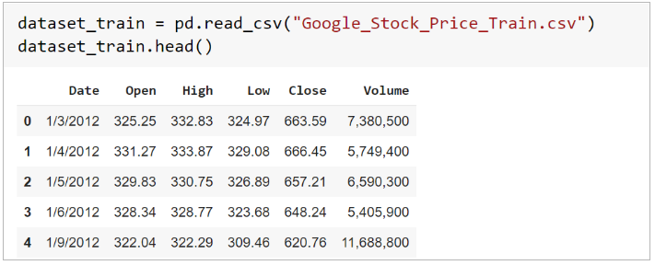
RESULTS
STOCK MARKET PREDICTION USING RNN
n

